Slide 1
Self Balancing Unicycle Team G
Team Members:
Spencer Carver
Kevin Collins (lead)
Ander Solorzano
Ruffin White
NI Client:
Andy Chang
Supervisor:
Robert Throne

Slide 2
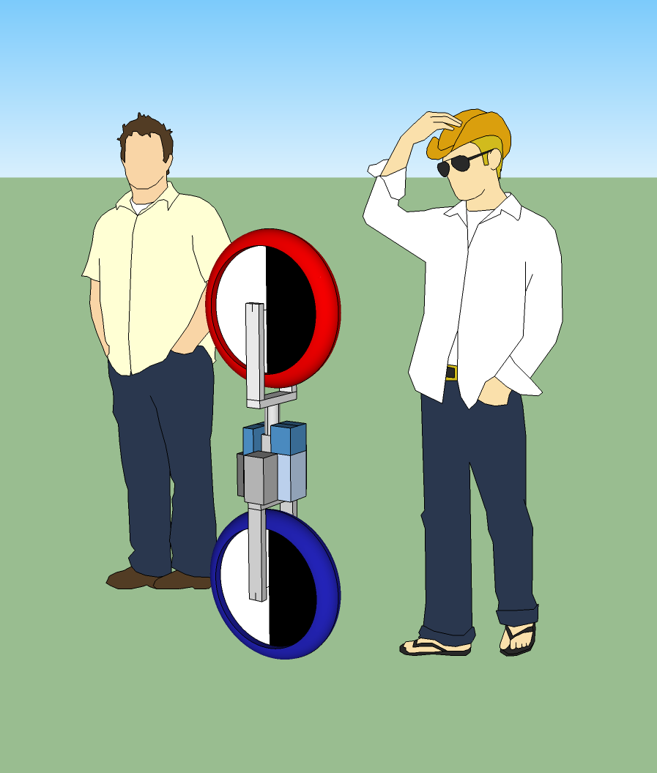
Project Overview and Client Expectations
Notes:
Good morning. I am kevin collins ___eveyone instroduces themselves_____ and we are team G of robotics capstone design. For our project, We have been asked by National Instruments to design and build a self balancing, autonomous unicycle robot to showcase NI’s newest robotics toolkit. The robot is self balancing in the sens that it will stay in the upright position National Instruments has developed a full real time controlling suite to be all encompassing with the LabVIEW Robotics toolkit and their Real-Time controllers. The end product should consists of an unicycle that is able to fall freely in all directions while a real-time control system manages to balance the system and return it to a stable position.

Slide 3
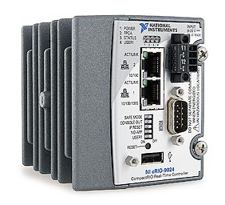
Project Plan
Robotics Environment Simulator
NIs cRIO real-time controller
State Space Control Design
Robot Construction
Debugging
Notes:
We will start by modeling the system in the labview robotics environment simulator, and develop our control algorithms using the simulator. Then, once we are confident in our control algorithms, we will use the cRIO to control our physical robot.

Slide 4
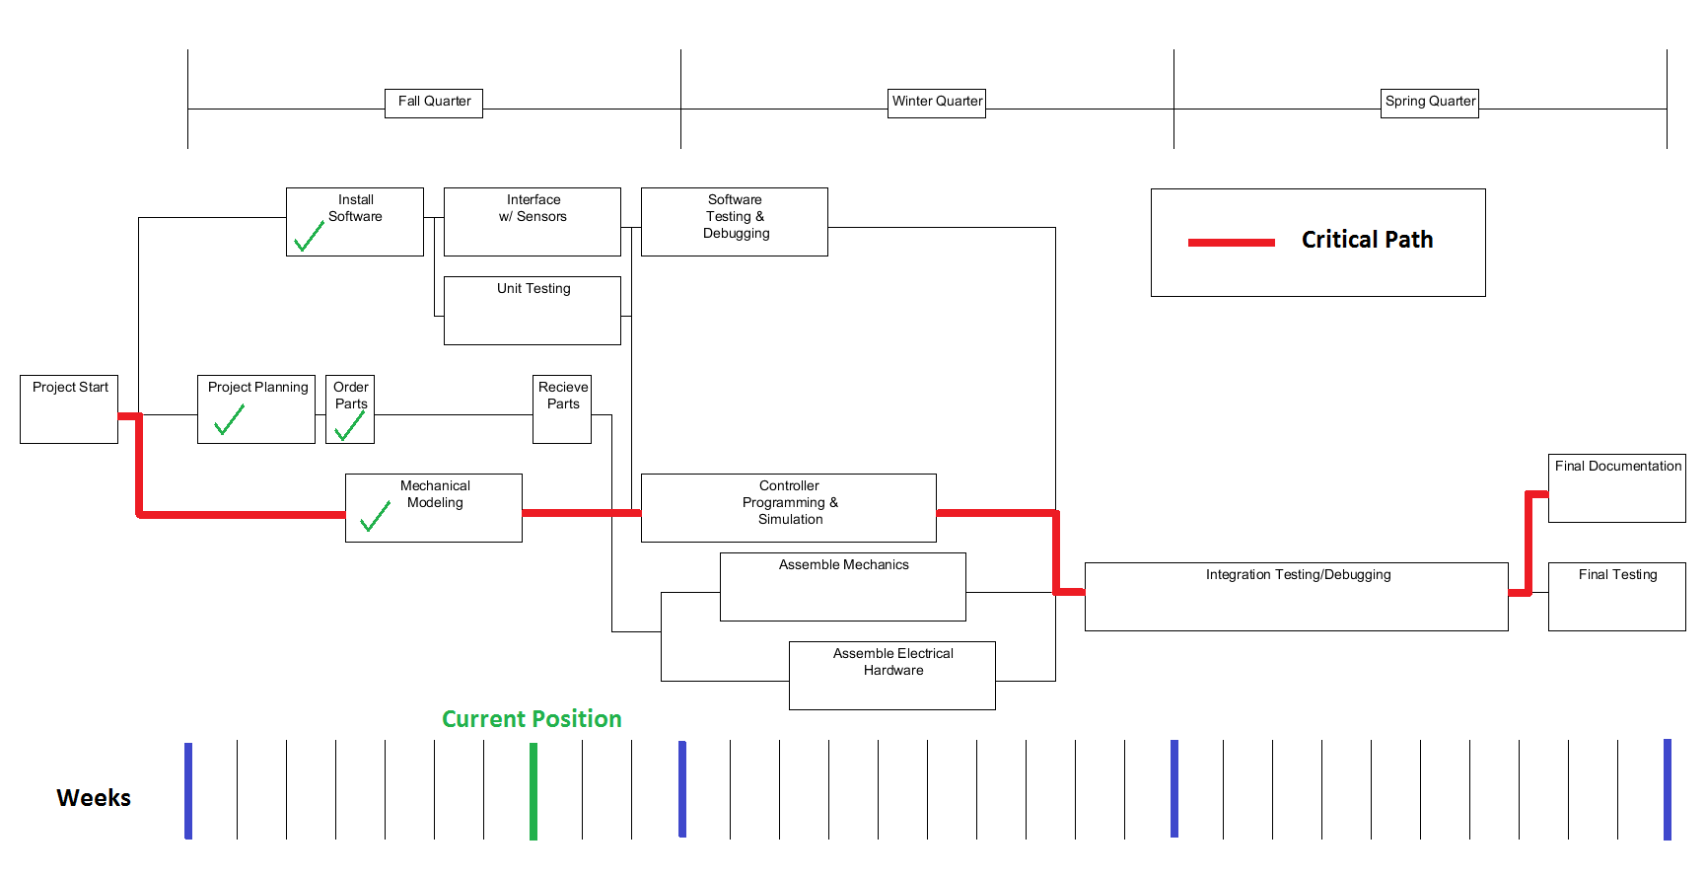
High-Level Block Diagram
Notes:
Here you can see our project plan. An important thing to note is how long we are leaving purely for debugging. We have a good understanding of the problem, and are confident that our solution will work, but one thing that we determined very early was that we would like to have a working version of it before the end of winter quarter to leave plenty of time to tune our control algorithm.

Slide 5
Breakdown of Tasks

Slide 6
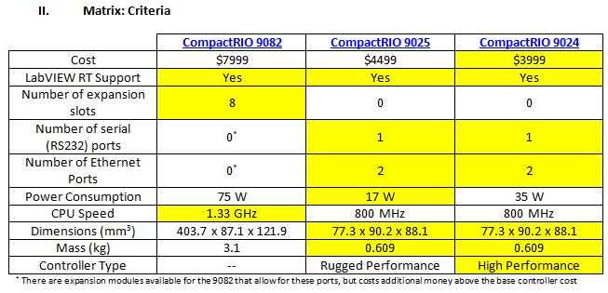
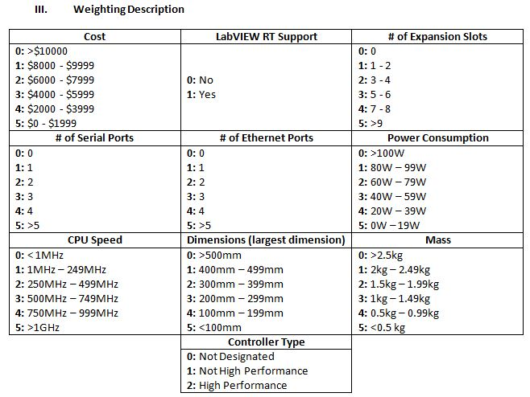
Decision Matrix for NI cRIO

Slide 7
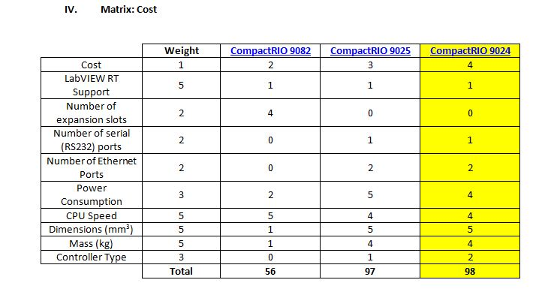

Slide 8
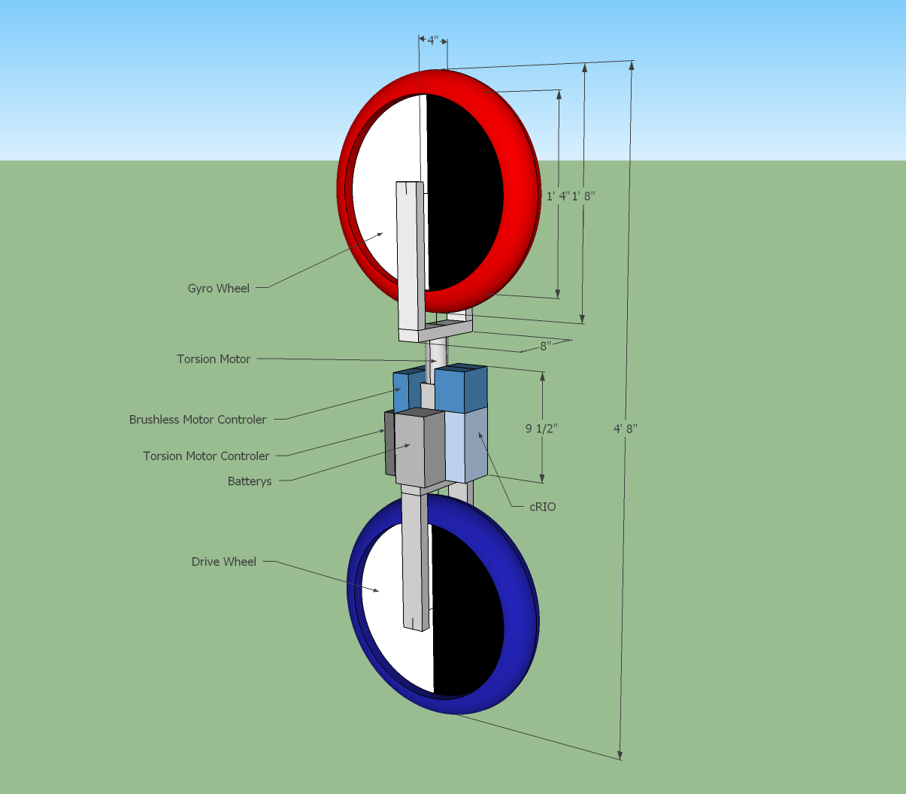
Suggested Design

Slide 9
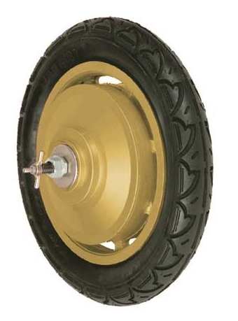
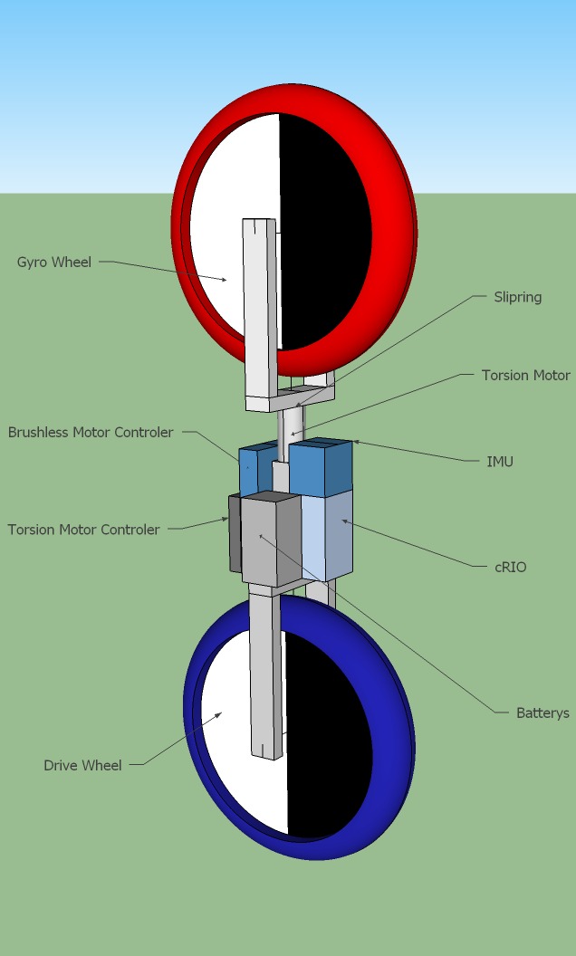
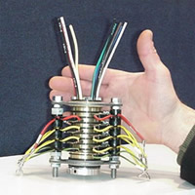
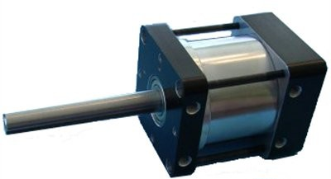
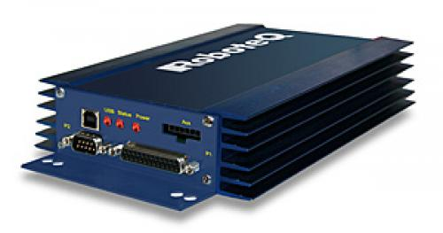
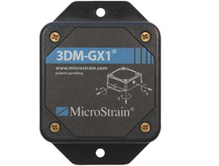
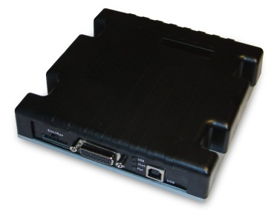

Notes:
Add a legend/number representation for all compenents!

Slide 10
Parts List (more like a budget list)
LabVIEW Robotics | $15,000
Real Time Controller | $8,000
Controller Interface Module | $600
Wheel and Gyro Motors | $150
Motor Controller | $350
Wrist Motor | $150
Wrist Motor Controller | $400
Battery | $90
Inertial Measurement Unit | $3,000
Total | $27,740

Slide 11
Budget Expenses

Slide 12
Control System Features
Self Balancing Unicycle
Non-linear system
Feedback
Real-Time operation
Dynamically unstable
Discrete time
Autonomous
Controllable system

Slide 13
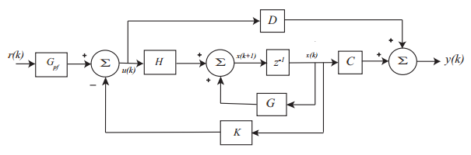


Control System Strategy
Non-linear problem → Linearize → Use state variable description
Discrete time state variable feedback system
State Variable Equations
x(k) = state vector
u(k) = input vector to the plant
y(k) = output vector from the plant
G,H,C,D matrices are constant
K = feedback gain matrix
$$x\left(k+1\right)=G∗x\left(k\right)+H∗u\left(k\right)$$
$$y\left(k\right)=C∗x\left(k\right)+D∗u(k)$$

Slide 14
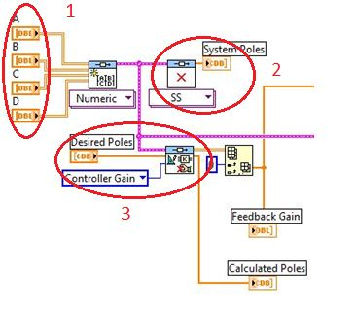
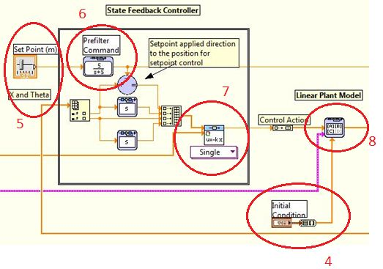
LabVIEW Control System Example
State Vectors A,B,C,D
Dynamic Analysis computes poles
Determines controller gain based on desired poles
Set initial conditions
Alter pole placement
Apply prefilter
Compute controller feedback output
Implement model in state-space form

Slide 15
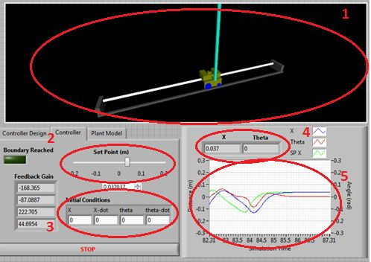
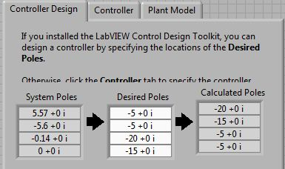
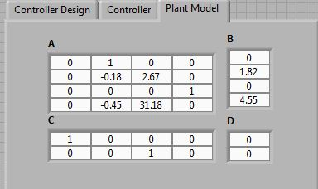
Control System Front Panel Example
System model
Alter system’s position
Set initial conditions
Position (x) and pole angle (Theta) real-time outputs
Plot of system output
Placing Poles in the system
Modify the plant model

Slide 16
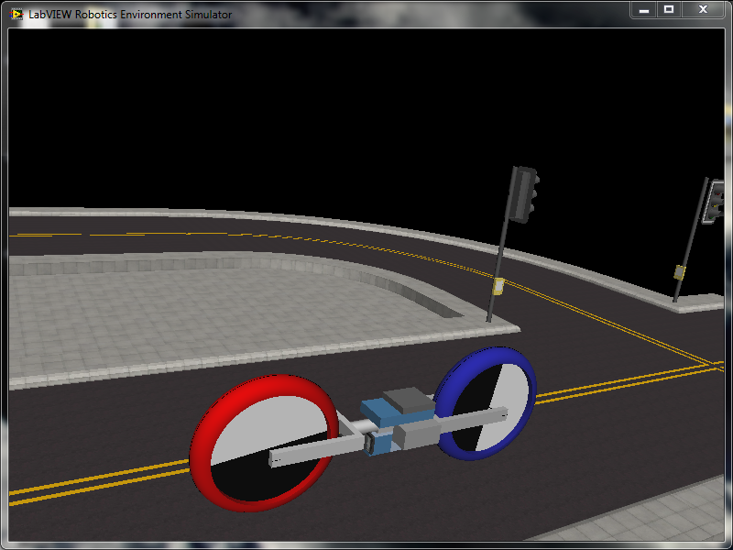
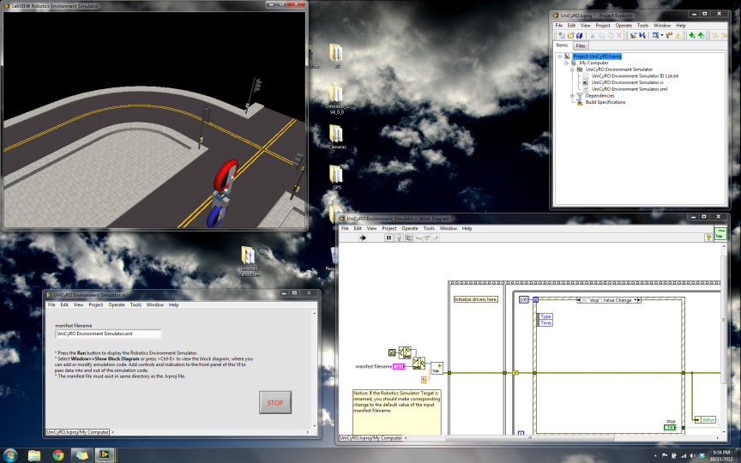
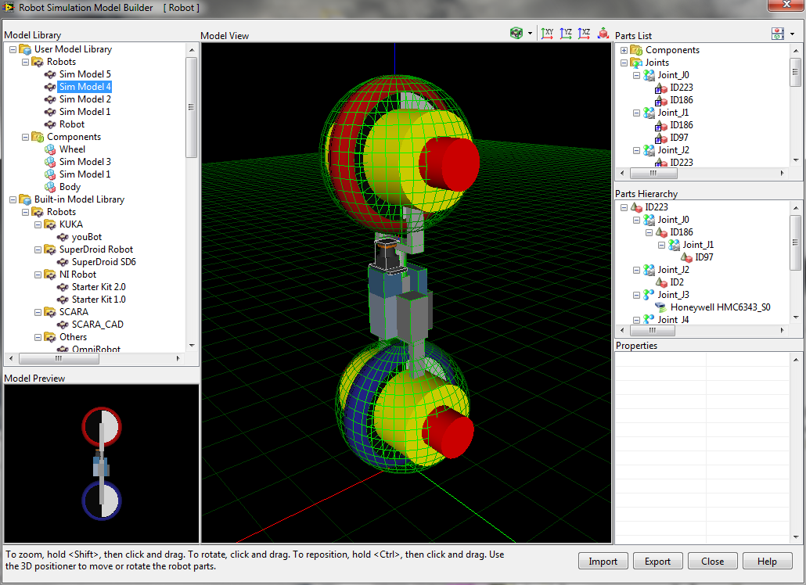
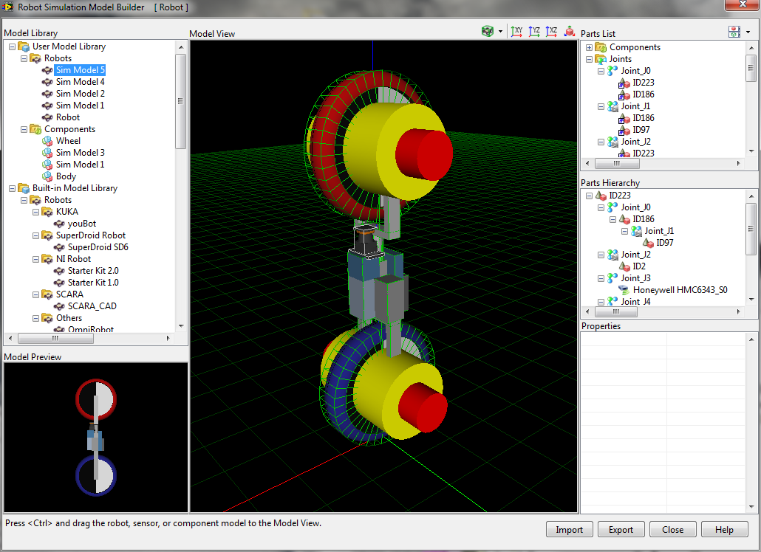
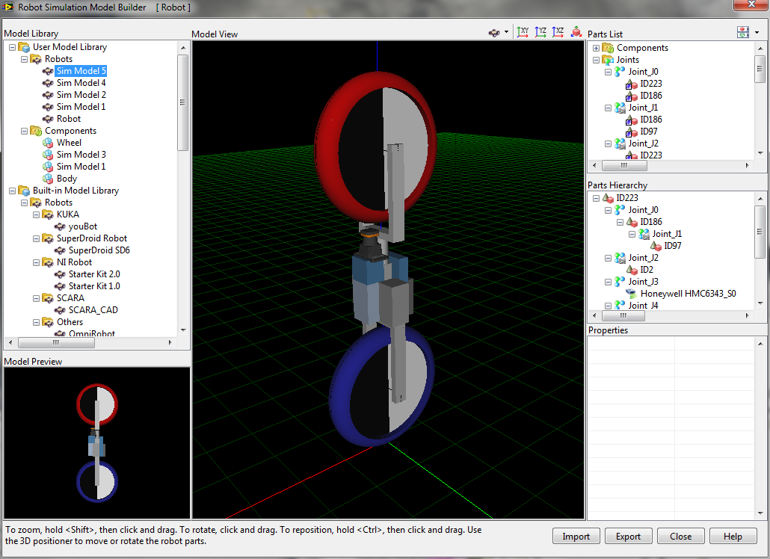
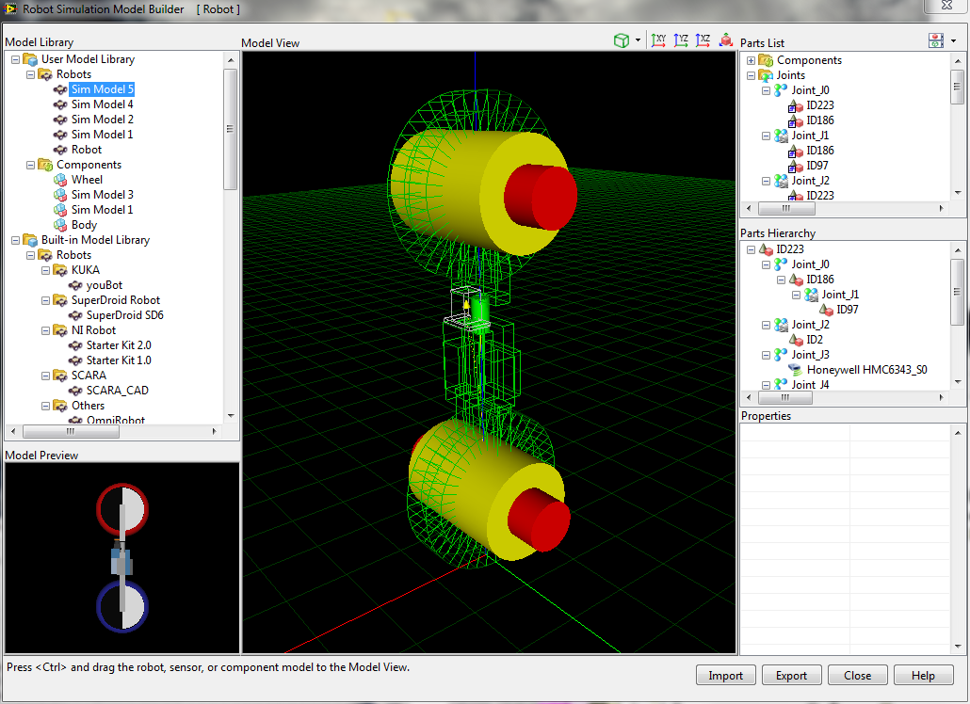
Simulation

Slide 17
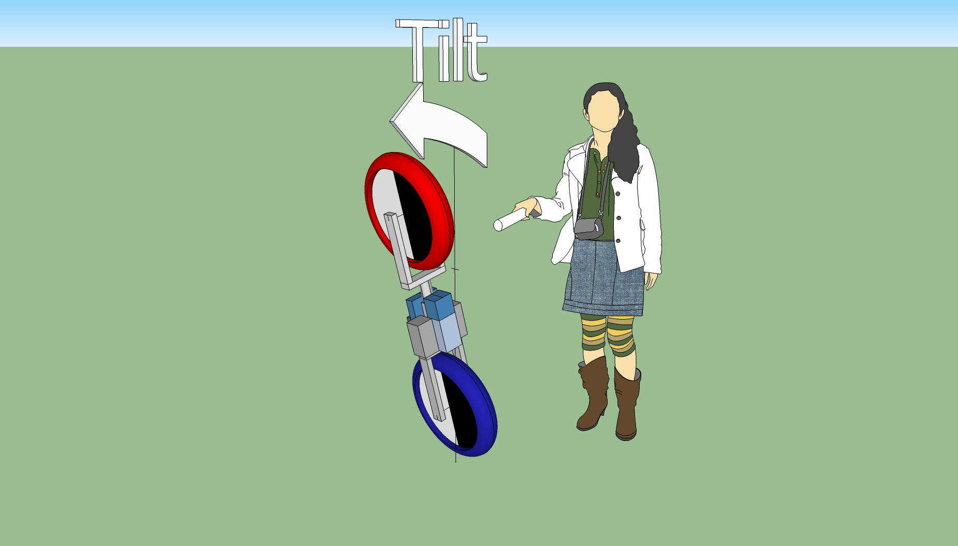
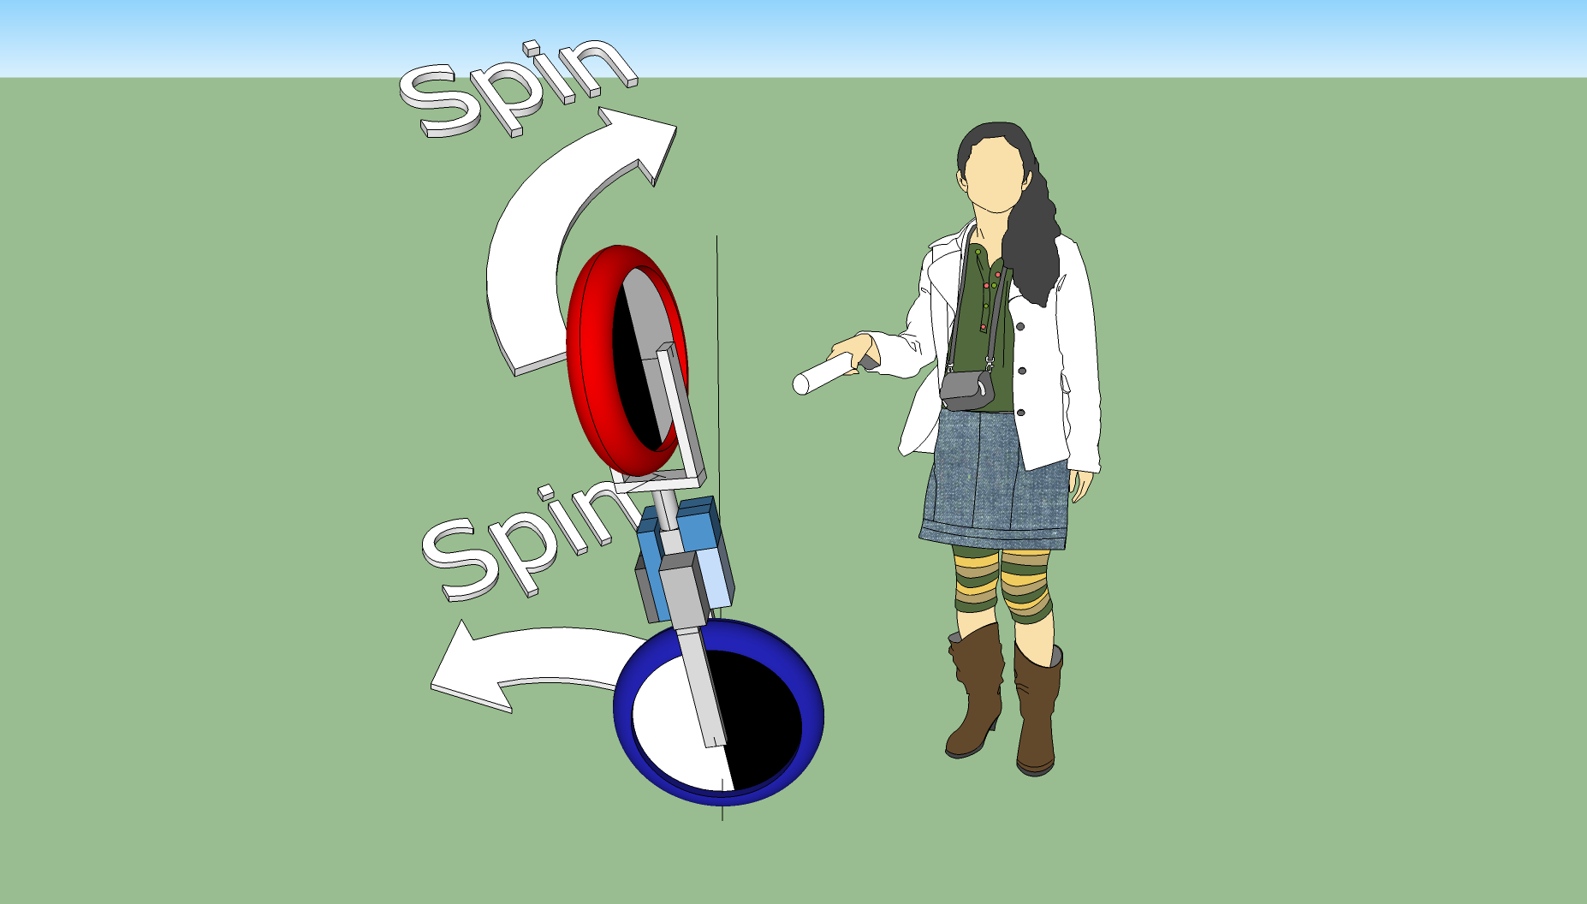
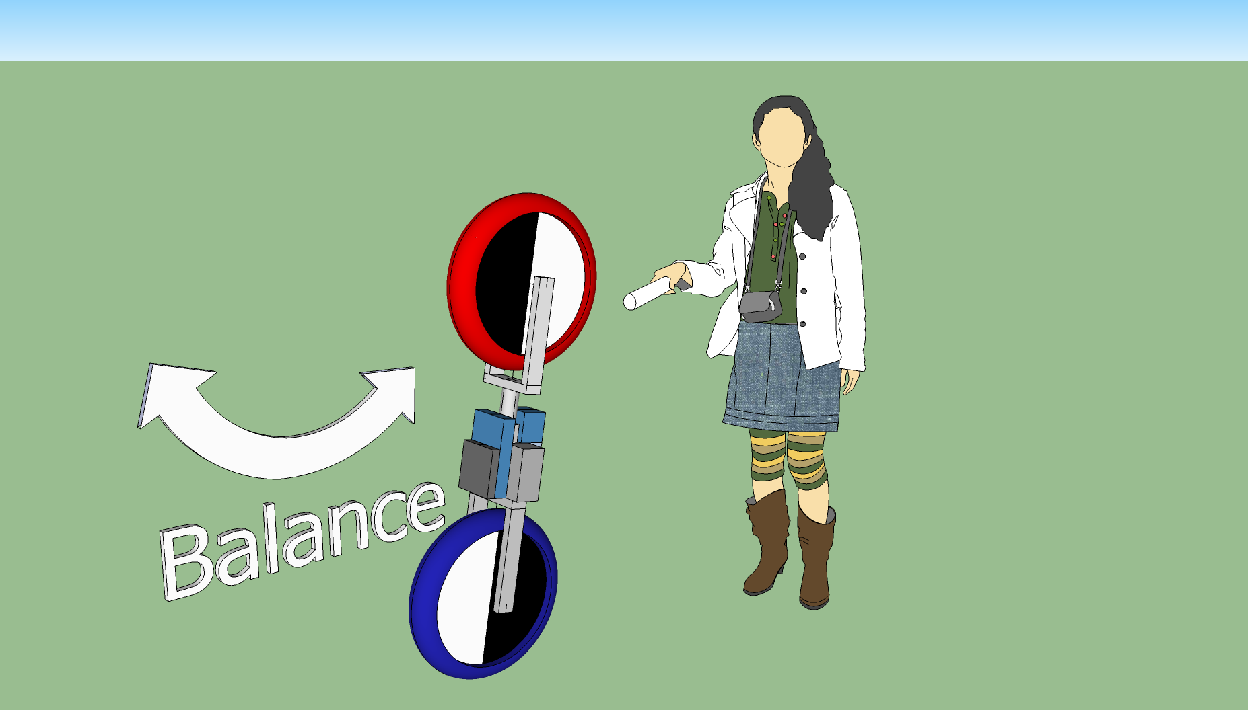
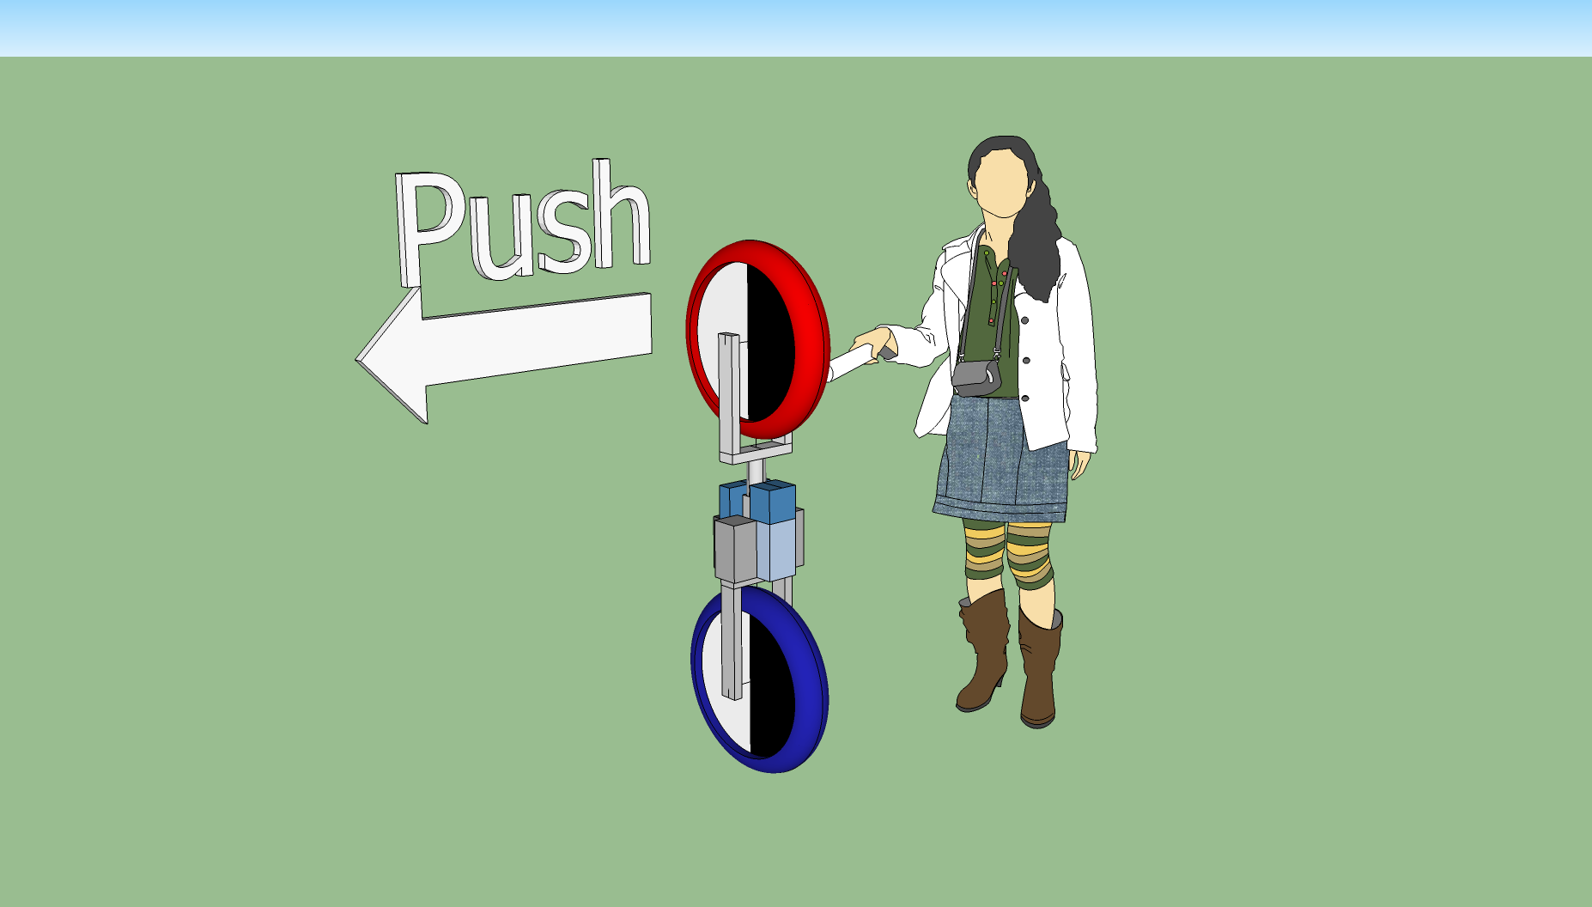
Operation

